Slide 1
Attention is all you need
Vikram Taviti

Slide 2
Background
Challenges in Traditional NLP Models:
RNNs & LSTMs: Sequential processing → slow, can't parallelize well
Vanishing gradients: Long-term dependencies are hard to learn
Limited context window: Only recent tokens matter the most
High training time: Especially with large datasets
The Breakthrough – Google's Transformer (2017):
Introduced "Attention is All You Need"
Fully attention-based architecture (no RNNs)
Enables parallel training
Handles long-range dependencies efficiently

Slide 3
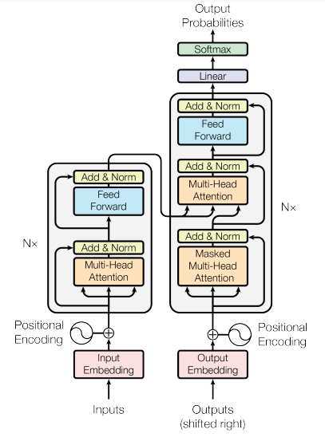
Transformers Architecture:

Slide 4
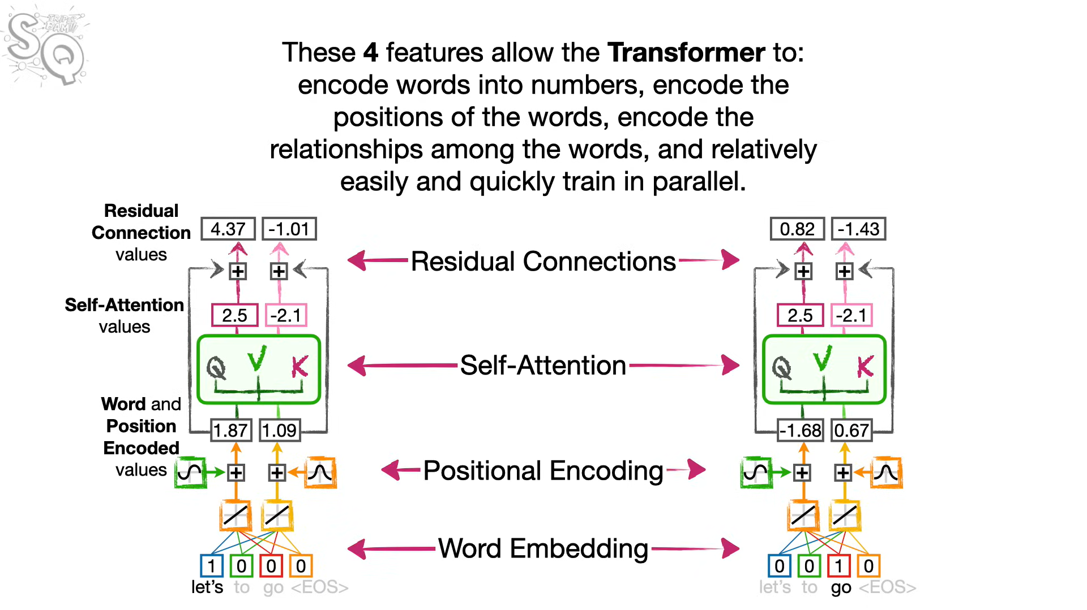

Slide 5
Word Embeddings
Convert words into fixed-size dense vectors
Capture semantic meaning (e.g., “king” - “man” + “woman” ≈ “queen”)
Pretrained embeddings: Word2Vec, GloVe, or learned during training
Positional Encoding​
Transformers have no sense of word order​
Positional encoding adds order info to embeddings​
Uses sine/cosine functions to encode position into vectors​
Simply,
word embedding = meaning
Positional Encoding = order

Slide 6
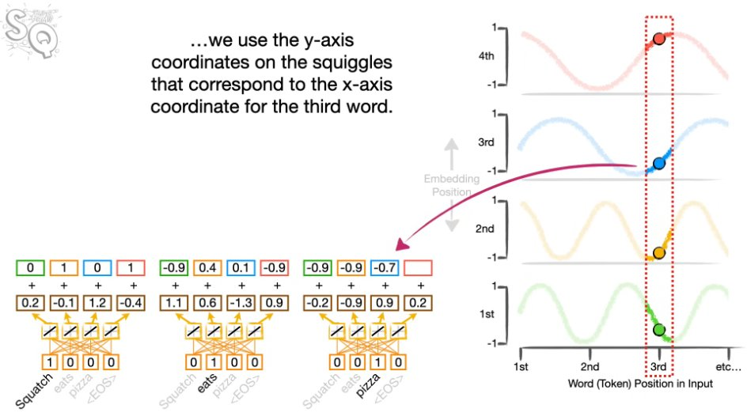

Slide 7
Self Attention:
Self-Attention
Helps model focus on relevant words in a sentence
Computes weighted importance of other words for each word
Allows global context understanding
Query, Key, and Value (QKV)
Each word is transformed into 3 vectors: Query (Q), Key (K), Value (V)
Attention Score = Similarity between Q and K
Output = Weighted sum of V’s based on attention scores

Slide 8
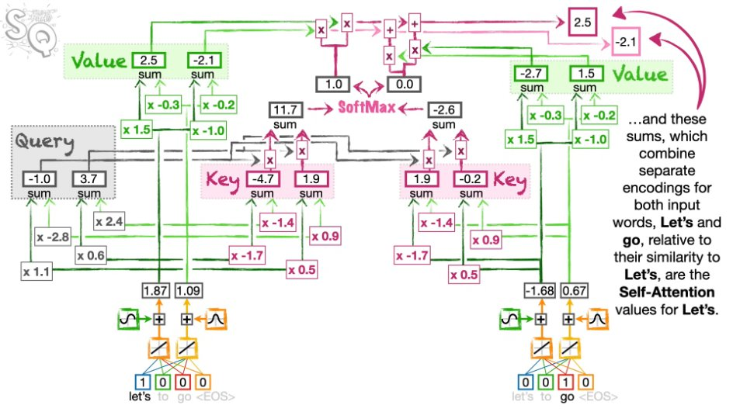

Slide 9
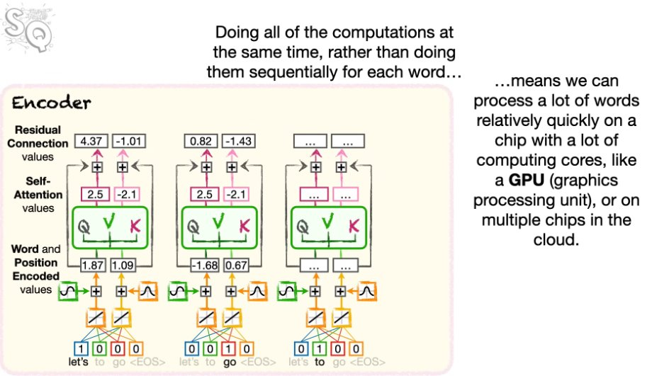

Slide 10
Encoder-Decoder Attention
Where it fits:
Used in the decoder, after masked self-attention
What it does:
Allows the decoder to attend to encoder outputs
Helps the decoder use the input sentence context while generating output
How it works:
Decoder’s Query + Encoder’s Key & Value
Helps align input tokens with output tokens (e.g., translation tasks)

Slide 11
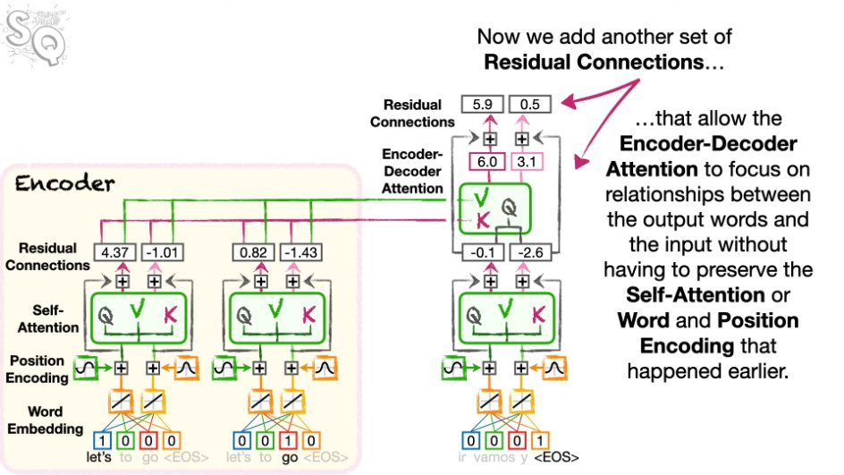

Slide 12
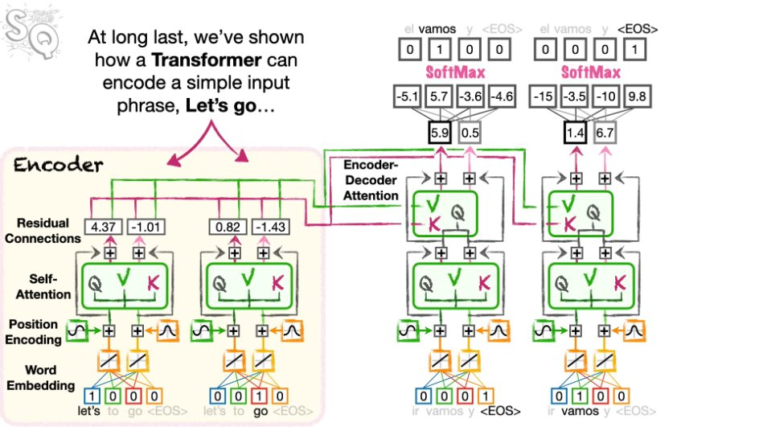
Image Credits: StatQuest

